Slide 1
EMPLOYEE DATA ANALYSIS USING EXCEL
STUDENT NAME: HARINI P
S REGISTER NUMBER :422200483
NM ID: 6D44A23740AC5F48AF6412D7DC299C
DEPARTMENT: B. COM ( ISM)
COLLEGE NAME: VALLIAMMAL COLLEGE FOR WOMEN

Slide 2
Project title
Employee Performance Analysis Using Excel

Slide 3
Agenda
Problem Statement
Project Over View
End Users
Our Solution And Proposition
Dataset Description
Modelling Approach
Result And Discussion
Conclusion

Slide 4
Problem Statement
Analyzing Employee Performance Enables Organizations To Optimize Productivity By Ensuring That Employees Are Working Efficiently And Effectively Towards Their Goals

Slide 5
Project overview
Analyze The Salary Of The Employee By Considering Various Factors Like Gender, Employee ID, Start Date, Employee Type, Department Etc. Different Categories Of Employee Salary Like Very High, High, Medium And Low

Slide 6

Who are the end users?

Slide 7
Our solution and its value proposition
Conditional Formatting – Missing
Filter – Remove
Formula – Performance Level
Pivot – Summary
Graph – Data Visualization

Slide 8
Dataset description
Employee Dataset – Edunet Dashboard
26 –Features
9 – Features
Employee Id – Numerical Value
Name –Text
Gender –Text
Salary – Numerical Value
Start Date – Numerical Value

Slide 9
The “WOW “ In our solution
We Use This Formula
Ifs(z8>=5,”very high”,z8>=4,”high”,z8>=3,”med”, True”, Low”)

Slide 10
Modelling
Data Collection
Naan Mudhalvan
Edunet Dashboard
Feature Selection
26 Features
9 Features
Data Cleaning
Colour Blank Values
Filter – Remove Blank Values

Slide 11
Salary Level
Very High
High
Medium
Low

Slide 12
Pivot Table
Employee id
Name
Gender
Salary
Salary level
Start date
Employee type

Slide 13
Chart
Employee id
Name
Gender
Salary
Salary level
Start date
Employee type
Data visualization

Slide 14
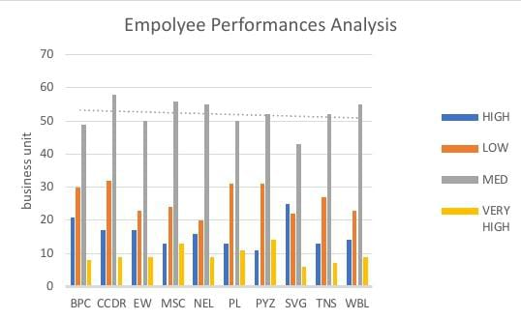
Results

Slide 15
Conclusion
While Comparing The Salary Level Of The Employee , The Employees Are Getting Their Salary According To Their Employee Type And Start Date

